Slide 1
Universities
&
Racial Diversity
Ashley Kim
Feb. 20th, 2025

Slide 2
Research Question
How Does the Location of Universities Affect Their Racial Diversity?

Slide 3
Tractable Data
&
Data Retrieval

Slide 4
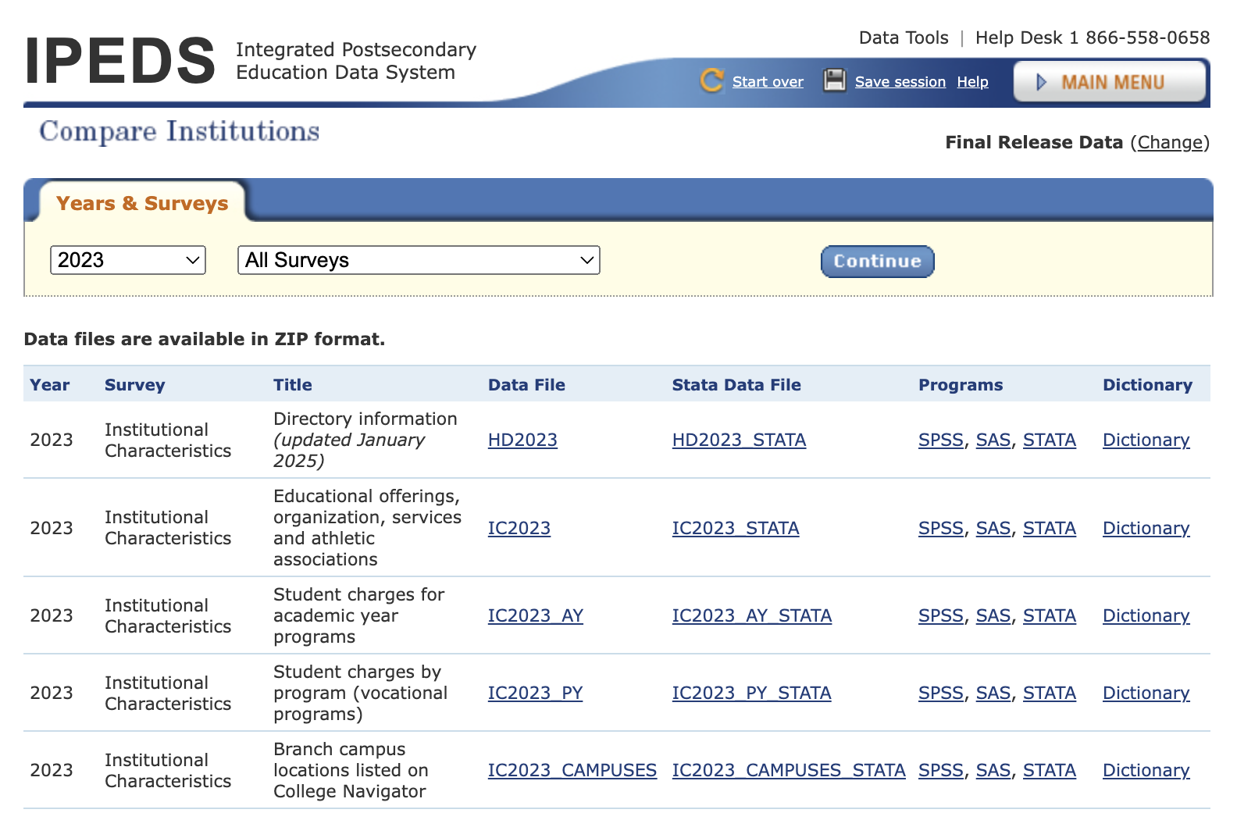
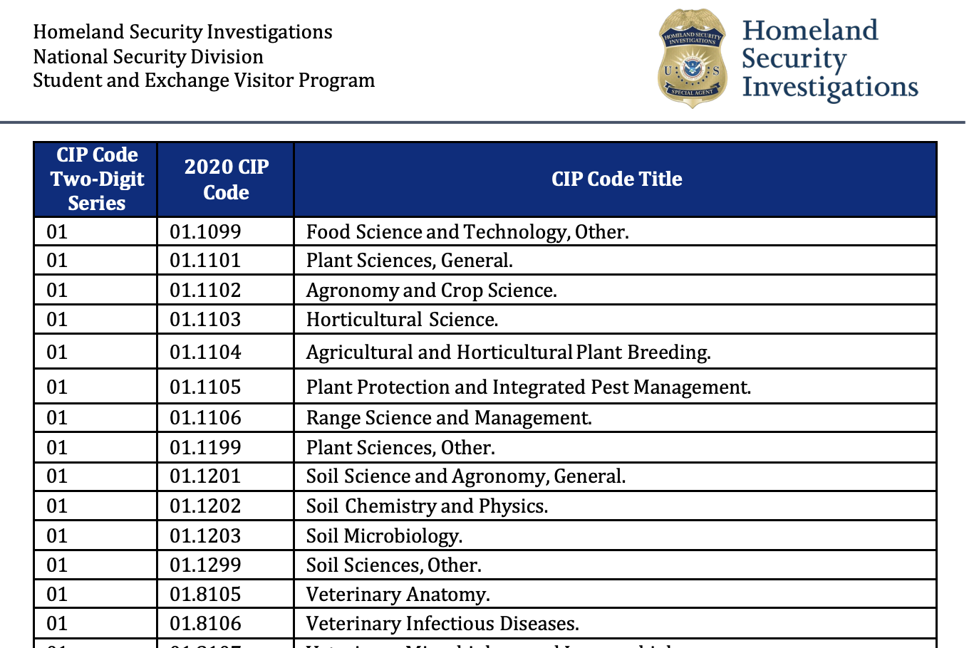
Tractable Data
Integrated Postsecondary Education Data System
A system administered by the National Center for Education Statistics (NCES) that provides detailed data on U.S. higher education institutions.
Available in annual reports, accessible to the public and researchers.
U.S. Immigration and Customs Enforcement
> 2024 DHS STEM Designated Degree Program List
A list that includes degree programs across U.S. institutions that are designated as STEM fields.

Slide 5
Data Retrieval
Downloaded CSV files from IPEDS:
Directory
Year: 2023 (most recent)
Variables: university names, locale codes, institution size, cbsa type, institution category
Completions
Year: 2014-2023
Variables: degree level, CIP codes, degrees awarded by race
Downloaded pdf file from ICE:
2024 DHS STEM Designated Degree Program List
Loaded all files into python
Merged Directory & Completions on UNITID and merged with DHS STEM LIST on CIP Codes

Slide 6
Data Cleaning & Preprocessing
15 Columns & 28,740 Rows (1,495 institutions)
Award Level | Filtered data for bachelor's degree
HBCU | Excluded HBCU colleges to remove outliers
Degree Type | Categorized the data into STEM and non-STEM degrees based on CIP codes
Diversity | Created a diversity score where Diversity = (non-white/total)

Slide 7
Exploratory Data Analysis

Slide 8
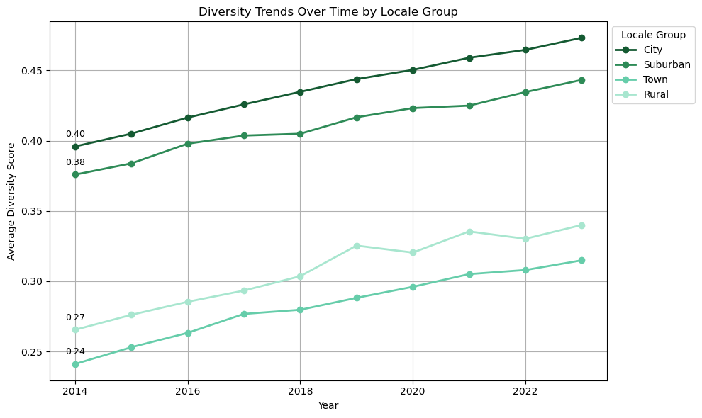

Slide 9
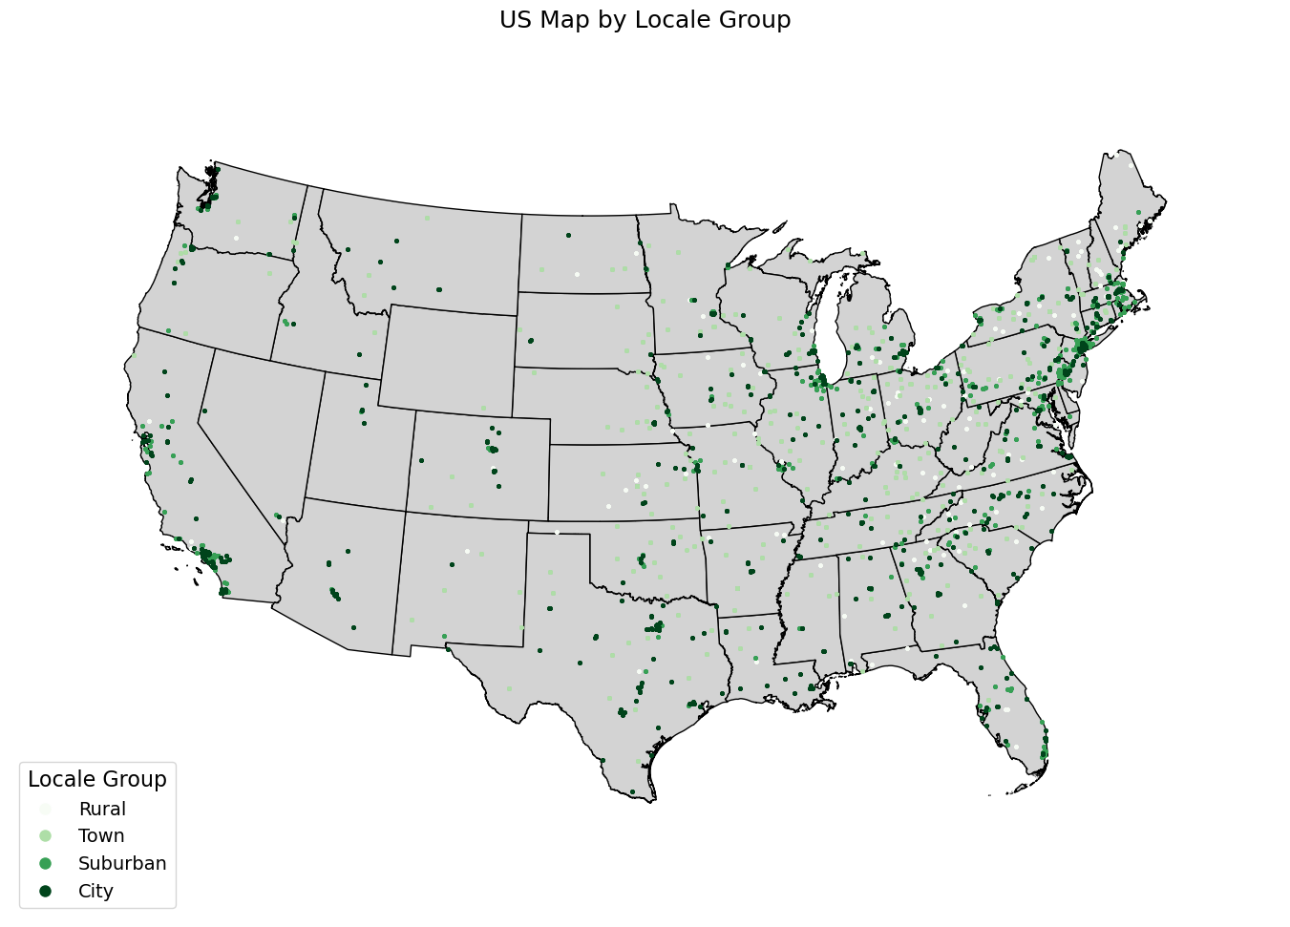

Slide 10
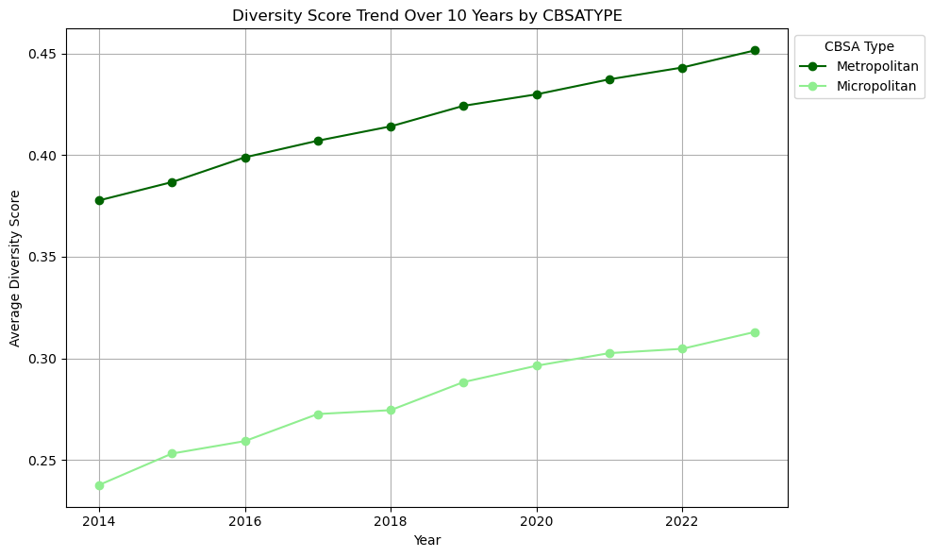

Slide 11
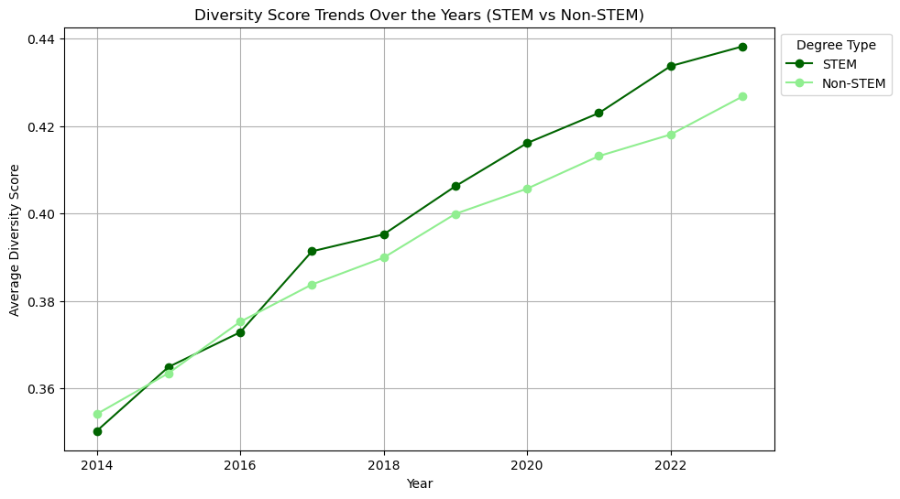
Notes:
Non resident vs resident

Slide 12
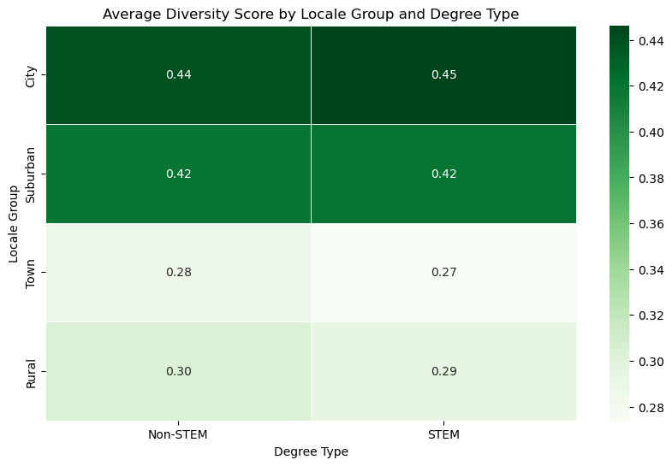
Notes:
Map institution - rural vs. urban
Geopandas - dataframes with coordinates
EPSG:2163
Matplotlib hue color

Slide 13
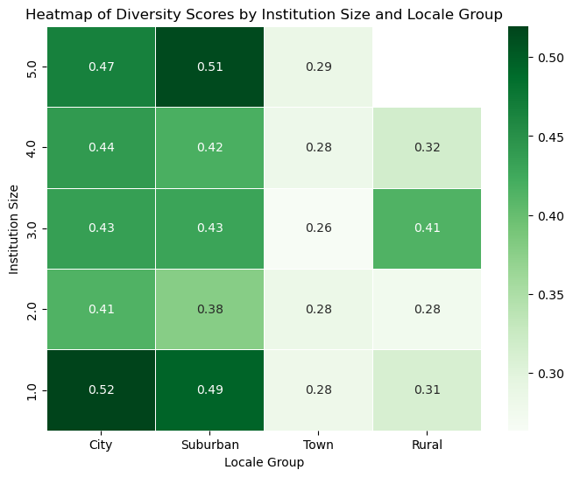
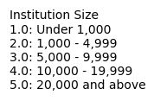

Slide 14
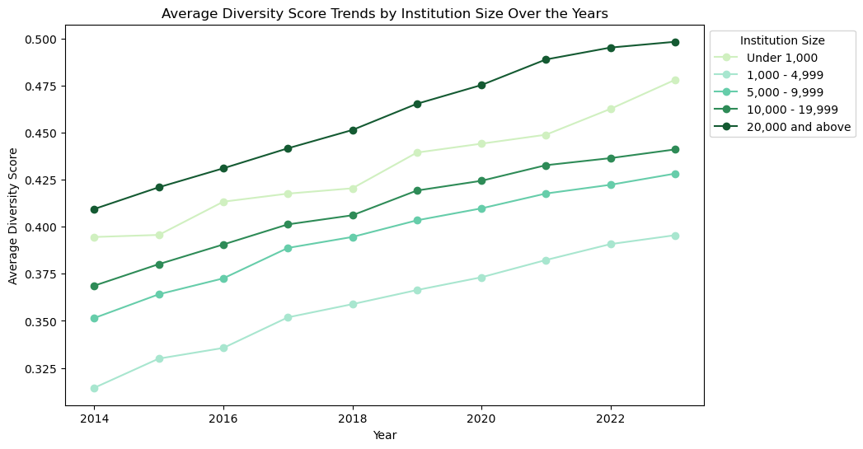
Notes:
Unique institutions in size group 'Under 1,000': 252
Unique institutions in size group '1,000 - 4,999': 683
Unique institutions in size group '5,000 - 9,999': 215
Unique institutions in size group '10,000 - 19,999': 159
Unique institutions in size group '20,000 and above': 154

Slide 15
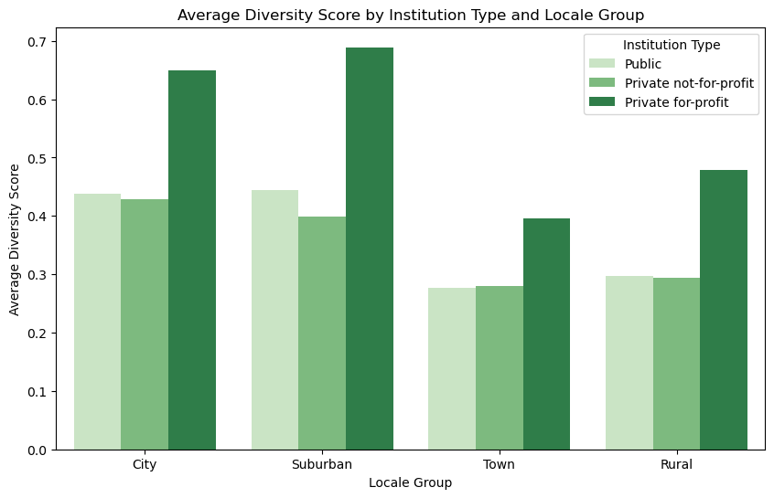

Slide 16
Conclusion
Findings:
Increasing trend in diversity score overall, but there seems to be a big gap in diversity between metropolitan and micropolitan areas
Higher diversity scores for private-for-profit universities
Increasing trend in gap between STEM and non-STEM degree diversity scores
Future Analysis:
Explore the Influence of Surrounding Area Diversity on University Diversity
Collect data on the diversity of the surrounding areas where universities are located.
Analyze how local demographic diversity correlates with university diversity scores over time
Explore the Influence of Institutional Funding on University Diversity
Collect data on the funding levels of universities, including public and private sources.
Analyze how variations in institutional funding correlate with changes in university diversity scores over time.

Slide 17
Implications for Stakeholders
Universities:
Recruitment: Adjust outreach to attract diverse students, especially in underrepresented areas.
Retention: Strengthen support programs to improve degree completion for underrepresented groups.
Policymakers:
Funding: Allocate resources to institutions in areas with lower diversity.
Policy Reform: Develop policies that promote racial diversity in higher education.
Students:
Informed Decisions: Offer data on diversity at universities to help students make choices that align with their values.
Campus Engagement: Encourage student-led initiatives that promote inclusivity and equitable opportunities.

Slide 18
Ethical, Legal, & Societal Implications
Ethical Implications:
Equity in Access: Ensure fair access to education for underrepresented groups.
Bias in Policies: Prevent policies from unintentionally reinforcing disparities.
Transparency & Accountability: Maintain transparency and accountability in diversity efforts.
Legal Implications:
Funding Allocation: Ensure funding decisions comply with anti-discrimination policies.
Anti-Discrimination Laws: Align recruitment and retention with affirmative action laws.
Data Privacy: Protect student data and uphold ethical data use.
Societal Implications:
Community Impact: Strengthen community integration through inclusive education.
Student Empowerment: Empower students to make informed choices and advocate for change.

Slide 19
Sources
DHS STEM Designated Degree Program List CIP Code Two-Digit Series 2020 CIP Code CIP Code Title.
“IPEDS Data Center.” Ed.gov, 2023, nces.ed.gov/ipeds/datacenter/DataFiles.aspx?year=2023&surveyNumber=-1&sid=37c646f5-c31a-4355-a887-a92d2c297362&rtid=1. Accessed 20 Feb. 2025.

Slide 20
Thank You

